Slide 1
The Owicki-Gries and Rely-Guarantee Methods

Slide 2
Introduction
The first formal method for verifying parallel programs was invented already in 1975 by Susan Owicki and David Gries and Leslie Lamport.
It was the starting point for further developments like
compositional rely-guarantee method for shared-variable parallelism
and the assumption-commitment method for synchronous message passing
Notes:
we distinguish parallel programs between shared-variable and message-passing parallelism, The present work deals with parallel programs that communicate via shared variables only.目前工作只考虑共享变量的并行

Slide 3
Introduction
The Owicki-Gries proof system provides a methodology for breaking down correctness proofs into simpler pieces.
First the proof reduces to showing that the annotation of each component is correct,
and that each assertion of an annotation is invariant under the execution of the actions of the other components (interference freedom).
Notes:
The main drawback of the Owicki-Gries method is that it is not compositional. To perform the interference-freedom tests for some component we require information about the implementation of all other components. A compositional proof method, however, should be able to infer the specification of the system from the specification of the components without knowing anything about their internal representation.
OG方法的主要缺点为不是组合的not compositional。为了对某些组件进行无干扰测试，我们需要有关所有其他组件实现的信息。然而，组合证明方法应该能够从组件的规范中推断出系统的规范，而不需要知道它们的内部表示。
The idea leading to a compositional proof method for parallel programs is to enrich the specification of each component with additional information about the interaction with the environment during execution.
导出并行程序的组合证明方法的思想是，在执行过程中使用有关与环境交互的附加信息来丰富每个组件的规范。

Slide 4
Introduction
Compositional rely-guarantee method for shared-variable concurrency was first proposed by Cliff Jones in 1981. A complete version of this system was later designed by Stølen in 1990.
Jones extended the traditional Hoare pre- and postcondition specification of sequential programs with two new predicates:
a rely condition specifying what the component expects from the environment,
and a guarantee condition expressing the task performed by that component, and how this task may influence the environment.
Notes:
These two conditions can be formulated
independently of the actual implementation of the components. Then, the
verification process consists of proving certain relations among the rely and
guarantee conditions of all components (and possibly of an overall environment). As a result, the proof rule for parallel composition can be formulated
in terms of the specifications without any need for additional information
about the implementation of the components, i.e. the resulting proof method
is compositional.

Slide 5
Introduction
The main improvements of the rely-guarantee method over Owicki-Gries are:
1. complexity : linearly VS exponentially.
2. applicability : open systems VS closed systems
Notes:
1. The complexity of the verification process grows linearly with the number of components, whereas in the Owicki-Gries method the number
of proof obligations grows exponentially.
2. It allows verification of open systems, i.e. systems whose interaction
with the environment can be specified without knowing the precise implementation of the environment. This makes the method suitable for
top-down design. In contrast, the Owicki-Gries method only works for
verifying closed systems, where the environment is fully characterized
in terms of concretely known processes.
1. 验证过程的复杂性随着组件的数量呈线性增长，而在Owicki-Gries方法中，证明义务的数量呈指数增长。
2. 它允许对开放系统进行验证，即可以在不知道环境的精确实现的情况下指定其与环境的交互的系统。这使得该方法适合于自顶向下的设计。相比之下，Owicki-Gries方法只适用于验证封闭系统，其中环境是根据具体已知过程完全表征的。
In general, programs defined using invariants which
cannot be easily expressed as a conjunction of local predicates [Chandy and
Misra, 1984, Francez and Rodeh, 1980] are difficult for compositional verifi-
cation methods.

Slide 6
Introduction
1.4 Parameterized Parallel Programs

Slide 7
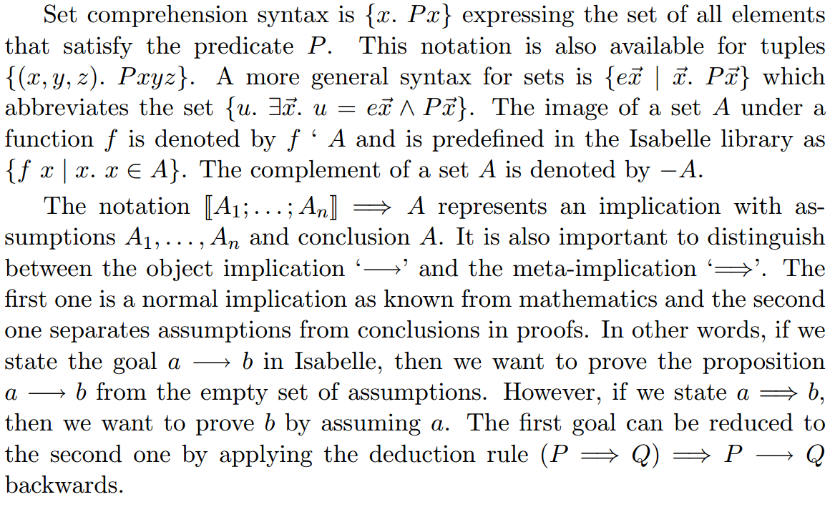
Introduction

Slide 8
OG -- Abstract Syntax
The programming language combines the following three layers:
Parallel commands include parallel composition of component programs as a construct. （ || ）
Component commands represent the language of the programs appearing within a parallel composition and can be synchronized via an await-command. Component programs are purely sequential programs, thus nested parallelism is excluded.（annotated）
Atomic commands are used for the bodies of await-statements, which are executed atomically.

Slide 9
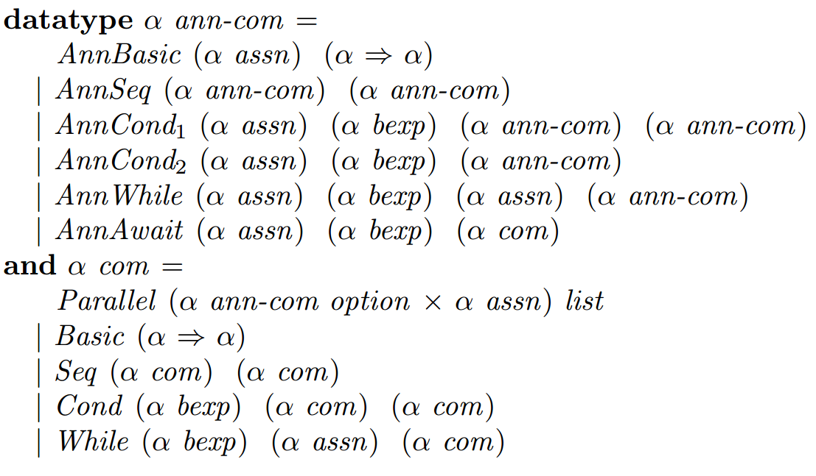
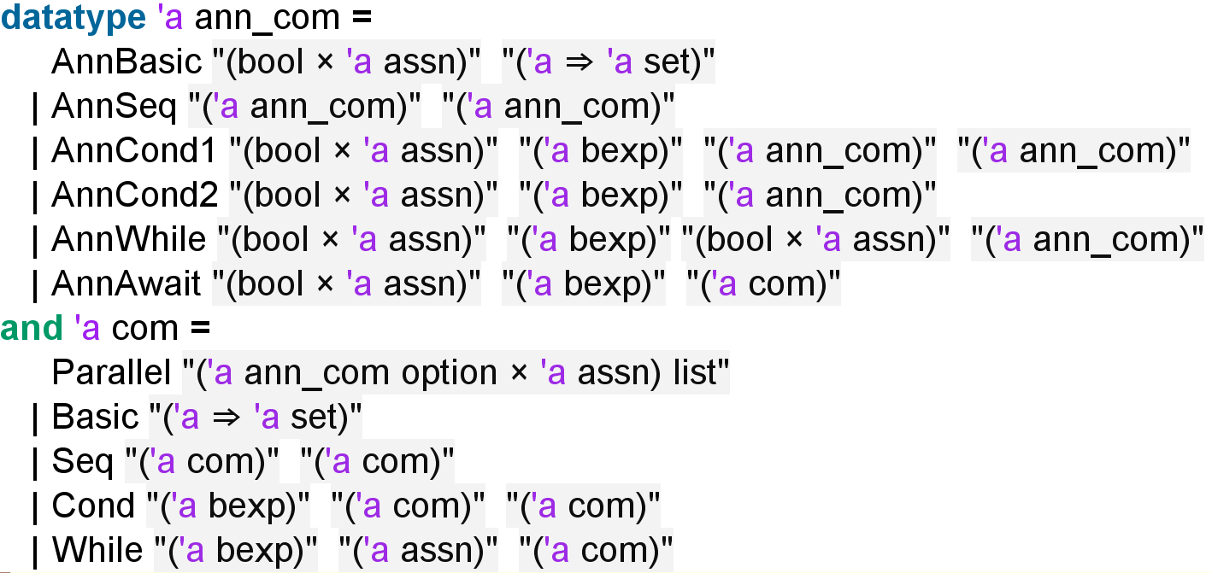
OG -- Abstract Syntax
α ann-com for annotated sequential programs
α com for atomic and parallel programs.
Notes:
为什么实际实现的时候断言多加了一个bool值组成了二元组？

Slide 10
OG -- Operational Semantics
The semantics defines the input/output behavior of programs, i.e. given a program c, its semantics Sem c defines a mapping from (initial) states to (final) states.
There are two classical ways of defining this mapping:
A denotational semantics defines Sem c by induction on the structure of c, as a partial function on states. In particular, fixed point techniques are used to deal with recursion.
An operational semantics defines first a transition relation between so-called configurations and then defines Sem c using this relation.
Notes:
Although the denotational style is more abstract and can theoretically handle all programming languages, it becomes very complicated for parallel
programs. In contrast, the operational semantics remains simple and is thus preferred for assigning meaning to parallel constructors.

Slide 11
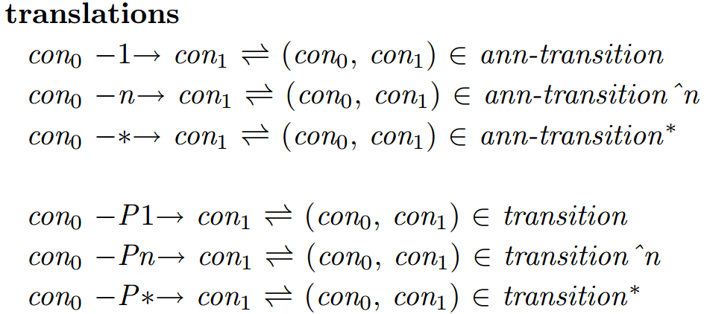
OG -- Operational Semantics
The Transition Relation in small-step rules
Syntax：

Slide 12
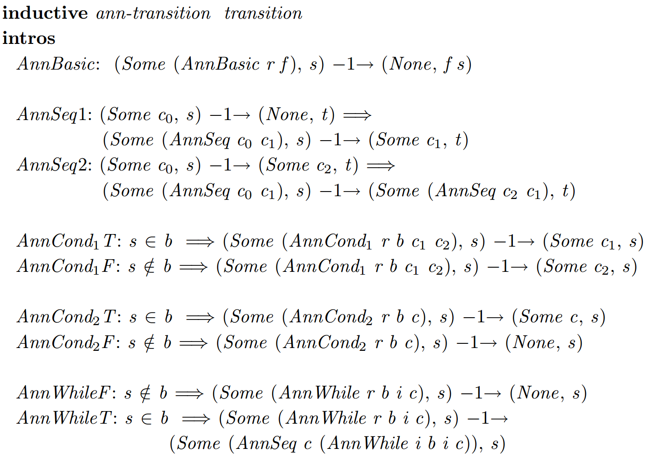
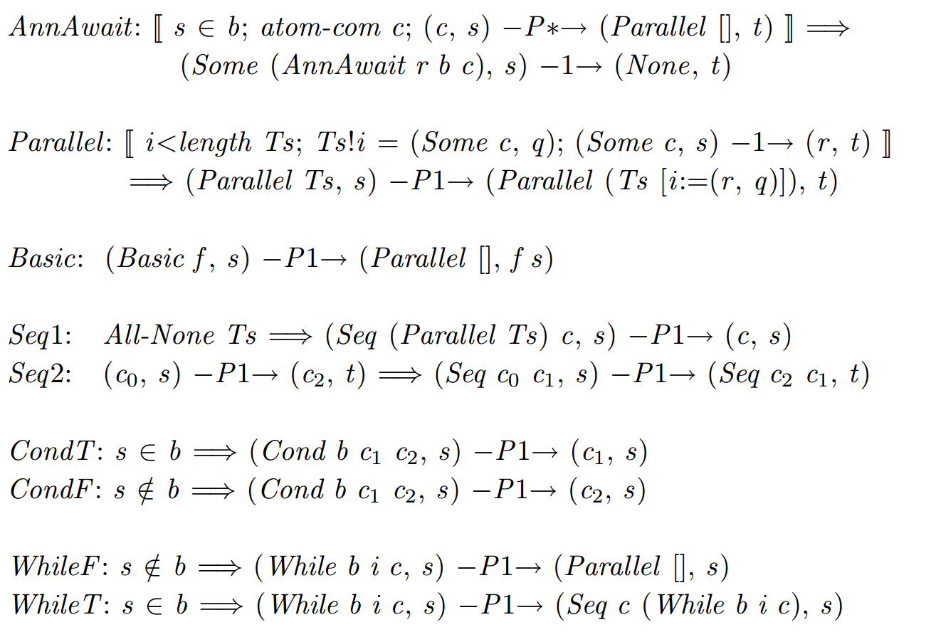
OG -- Operational Semantics
The Transition Relation in small-step rules
Semantics：
Notes:
Ts : ('a ann_com option × 'a assn) list

Slide 13
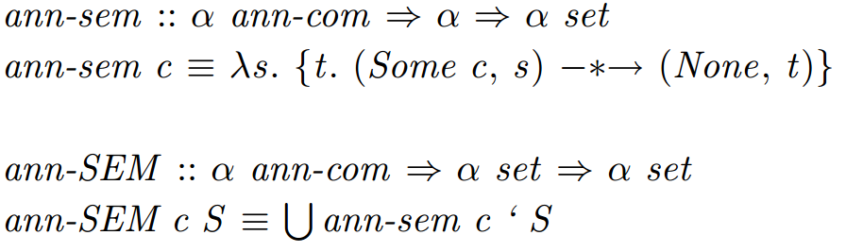
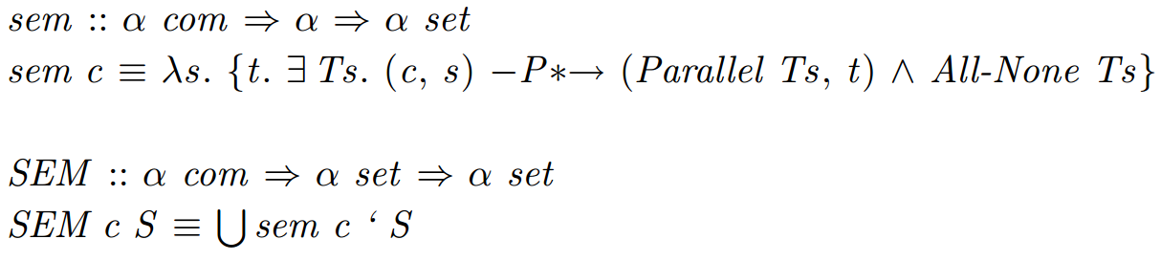
OG -- Operational Semantics
semantics of annotated commands (partial correctness) (why?)
semantics for non-annotated programs (partial correctness)
Notes:
Both approaches differ in the way they deal with divergent computations. The former considers the possibility of divergence while the latter one ignores it.
In this work we concentrate on proving partial correctness, thus, only this interpretation will be formalized.
1. 部分正确语义（Partial Correctness Semantics）
部分正确语义关注的是程序在给定输入下是否能够达到预期的输出状态，但不关心程序是否会终止。不考虑程序的终止性。如果程序终止，且最终状态满足后置条件，则认为是正确的。
2. 完全正确语义（Total Correctness Semantics）
完全正确语义不仅关注程序在给定输入下是否能够达到预期的输出状态，还关注程序是否能够终止。完全正确语义要求程序在任何符合前置条件的输入下都必须终止，并且在终止时满足后置条件。

Slide 14
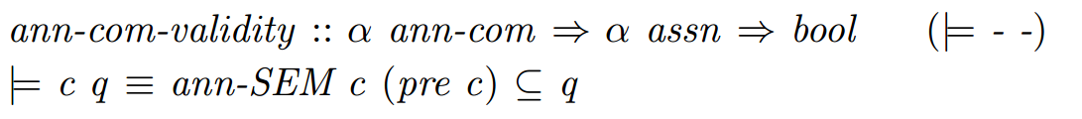
OG -- Validity of Correctness Formulas
Informally, we say that a program is correct if it satisfies the intended input/output relation, where input and output are usually described as predicates over states, or equivalently as sets of states.
Hoare: we say that a formula {p} c {q} is valid (or true) in the sense of partial correctness if every terminating computation of c that starts in a state s satisfying p ends in a state satisfying q.
OG:
Notes:
The main properties of such systems are soundness and completeness.
The rules of a sound system inductively define a set of correct programs. If
the system is also complete then it defines the set of all correct programs.

Slide 15
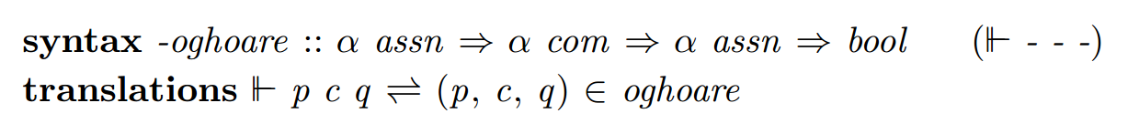
OG -- The Proof System
Proof System for Atomic Programs
The set of derivable correctness formulas of atomic programs is inductively defined by the set:
The syntax ||- p c q denotes that the triple (p, c, q) is an element of the inductively defined set. This amounts to say that it can be derived in the system.

Slide 16
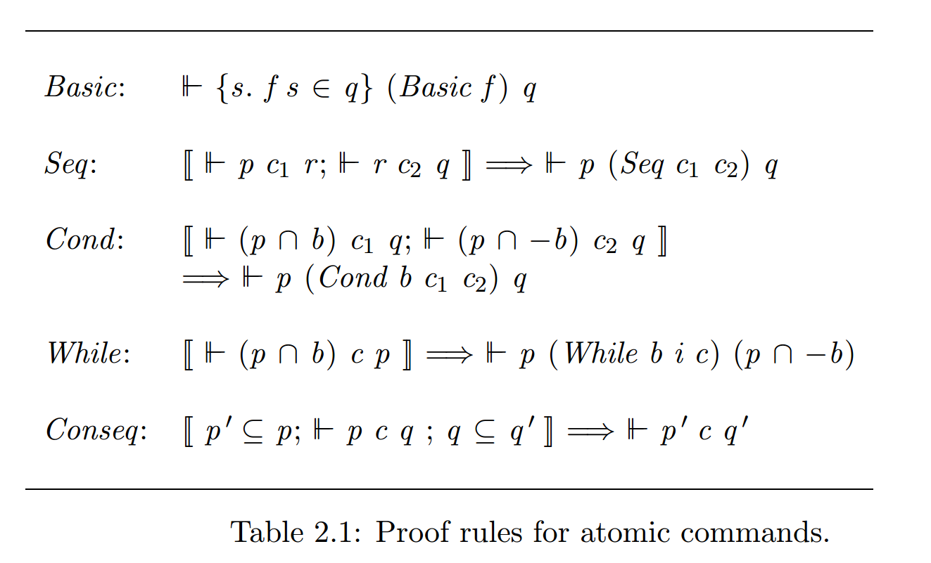
OG -- The Proof System
Proof System for Atomic Programs

Slide 17
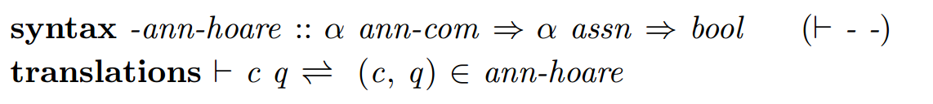
OG -- The Proof System
Proof System for Component Programs
The set of derivable proof outlines is defined by the constant:
A pair (c, q) is an element of the set if it has derivation in the system, denoted |- c q:

Slide 18
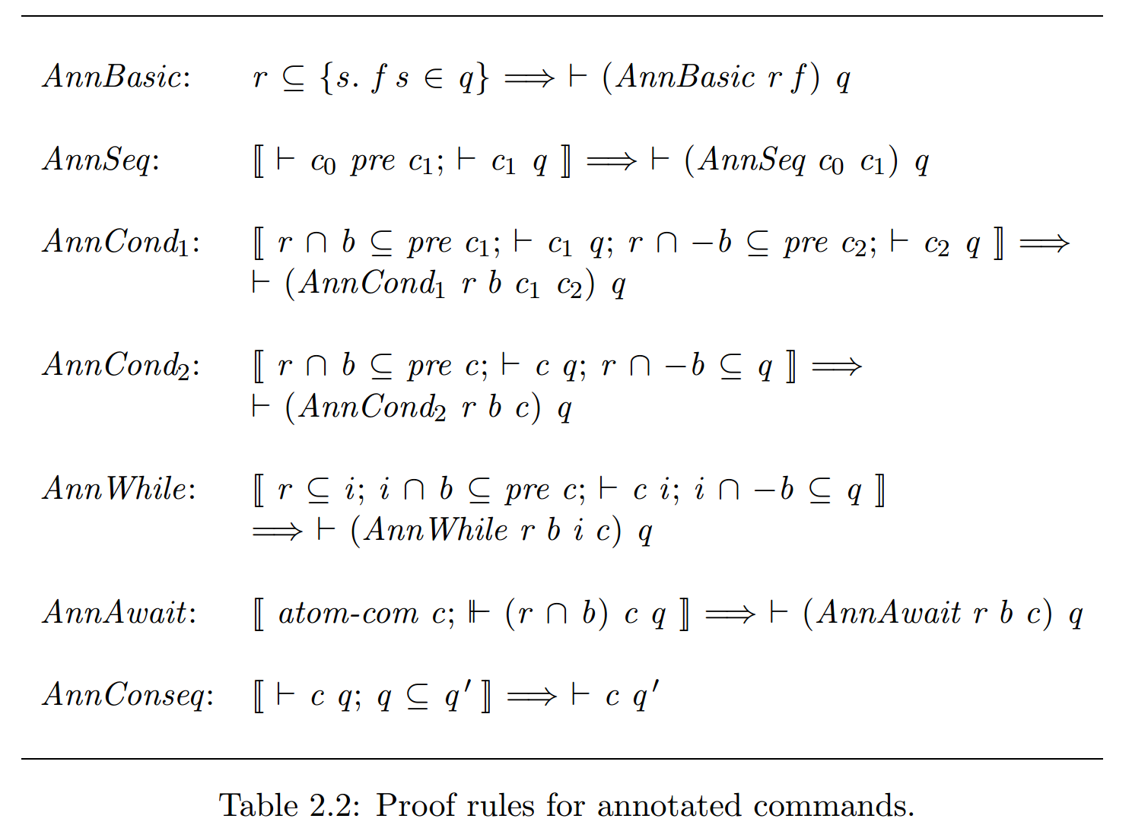
OG -- The Proof System
Proof System for Component Programs

Slide 19
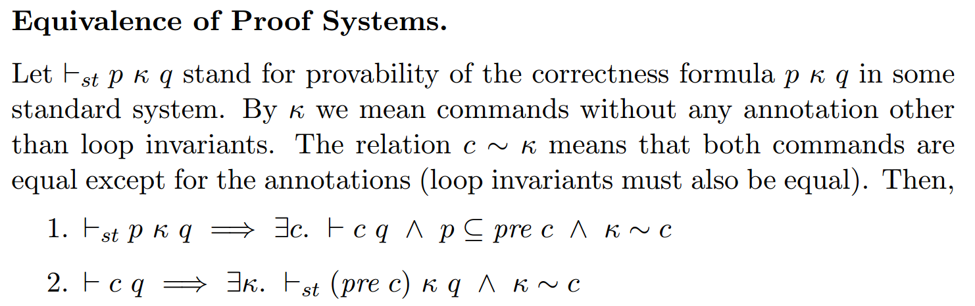
Notes:
This concludes the proof of equivalence of our system of rules and a standard one like the one in [Apt and Olderog, 1991], where preconditions are not directly attached to commands.

Slide 20
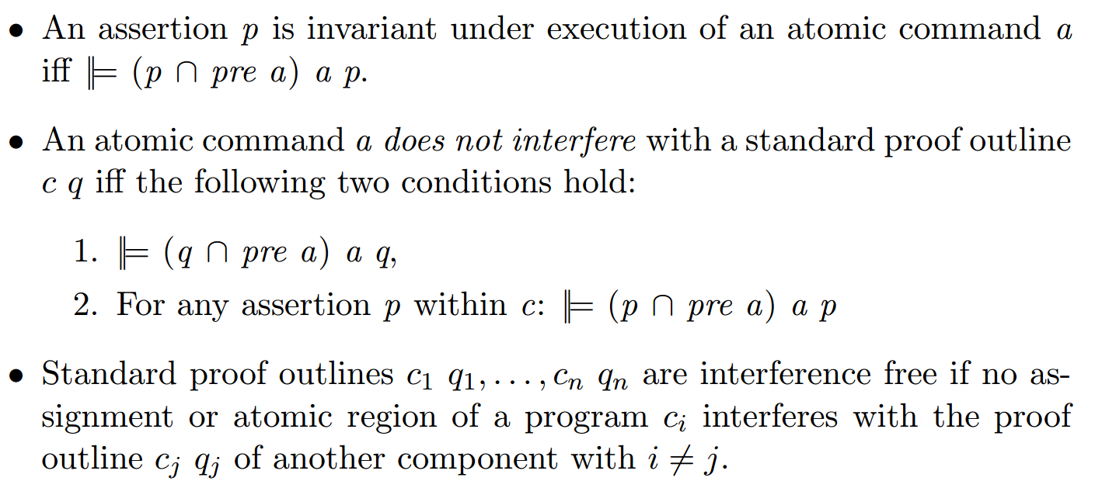
OG -- The Proof System
Proof System for Parallel Programs
interference freedom:
Given two component program’s proof outlines c q and c’ q’ , showing interference freedom means proving that all assertions in the former remain invariant under execution of all assignments or atomic regions in the latter, and vice versa.
Notes:
Unfortunately, proving that all proof
outlines are correct independently of the environment is not sufficient to
conclude that the input/output specification of a parallel composition is the
intersection (assertions are modeled as sets) of the input/output specification of each component.

Slide 21
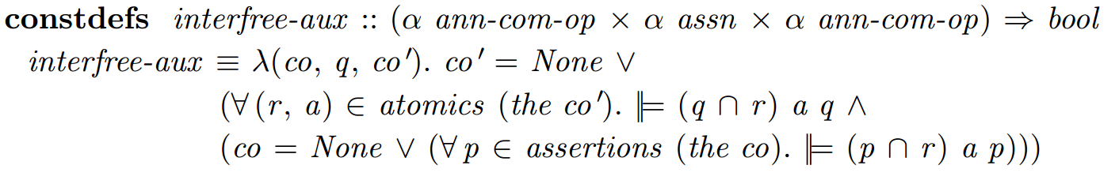
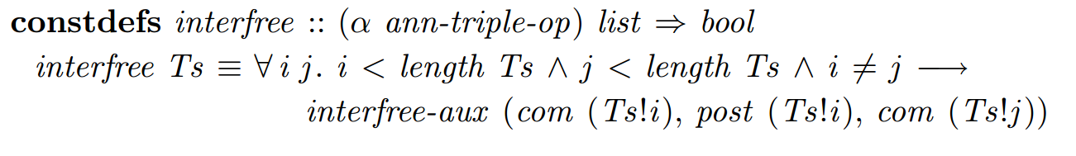
OG -- The Proof System
Proof System for Parallel Programs
interference freedom:
Notes:
Unfortunately, proving that all proof
outlines are correct independently of the environment is not sufficient to
conclude that the input/output specification of a parallel composition is the
intersection (assertions are modeled as sets) of the input/output specification of each component.

Slide 22
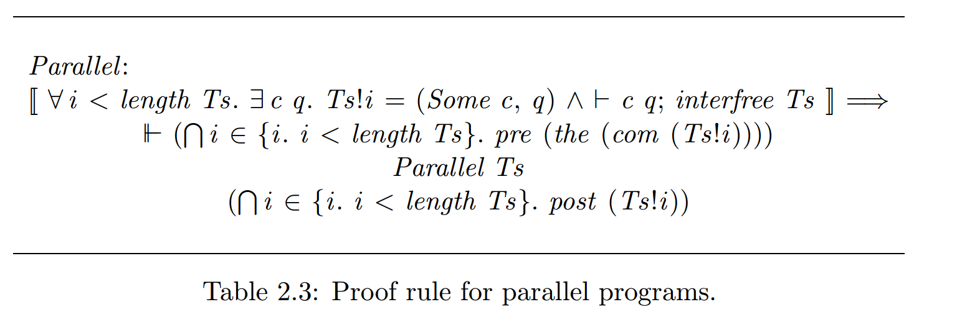
OG -- The Proof System
Proof System for Parallel Programs
interference freedom:
Notes:
Unfortunately, proving that all proof
outlines are correct independently of the environment is not sufficient to
conclude that the input/output specification of a parallel composition is the
intersection (assertions are modeled as sets) of the input/output specification of each component.

Slide 23
RG -- compositional version of OG
A rely-guarantee specification defines four sets:
the sets of initial and final states (pre and postcondition)
and the sets characterizing the effect of actions performed by the environment or by the component itself (rely and guarantee conditions).
The idea of the rely-guarantee method is to record the interference information in the specification of each component. This information consists of the rely condition stating what the component expects from the environment, and the guarantee condition, stating the effect of the component itself on the environment. By using the information given by the rely and guarantee conditions of each component, the verification of a parallel program can be carried out in a compositional way.
Notes:
The compositionality of this method has two major advantages over the
non-compositionality of Owicki-Gries. First of all, it drastically reduces the
complexity of the verification process. The number of correctness proofs
in the rely-guarantee formalism increases only linearly with the number of
parallel components, while exponentially in the Owicki-Gries method. Secondly, it allows the verification of so-called open systems, i.e. systems where
a specified margin of interaction from an arbitrary environment is permitted.
Then, new components, whose actions respect this margin, can be added a
posteriori. The verification of the new system can be done without looking
into the structure of the previously verified program. This makes the method
adequate for top-down development of parallel systems. In constrast, the
Owicki-Gries method only works for closed systems, where all component
programs must be simultaneously known. If a new component program is
added to the parallel composition, the verification process must be restarted
due to the non-compositionality of the interference freedom test.

Slide 24
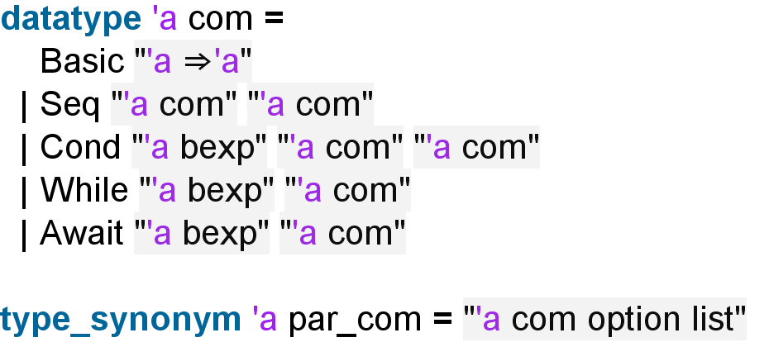
RG -- Abstract Syntax
Component programs are not presented as proof outlines, so intermediate assertions can be omitted.
Parallelism is defined in a separate layer with type α par-com; it is simply a list of optional component programs.
Notes:
This is analogous to the
constructor Parallel defined in the Owicki-Gries language. For simplicity,
we consider parallelism only at the top level, i.e. no nested parallelism.
Moreover, contrary to the formalization in 2.1 parallelism appears as a single
construction, i.e. there are neither sequential nor if- nor while-constructions
for parallel programs. This way, we reduce the number of constructors and
avoid having to duplicate proofs.

Slide 25
RG -- Operational Semantics
The execution of a component program is characterized by an operational semantics that distinguishes between two kinds of transitions:
program (or component) transitions, performed by the component itself, and
environment transitions, performed by another component or an arbitrary environment.
Execution of programs is described via computations, which record the sequence of transitions of both kinds. This semantics allows us to define the computation of parallel programs in terms of the computations of the components via a special operator

Slide 26
RG -- Operational Semantics
Semantics of Component Programs
A configuration is a pair (P, σ), where P is some program or None standing for a terminated program, and σ is a state.
A transition is represented by a labelled arrow connecting the beginning and ending configurations. There are two kinds of transitions:
Environment transitions
Component transitions

Slide 27
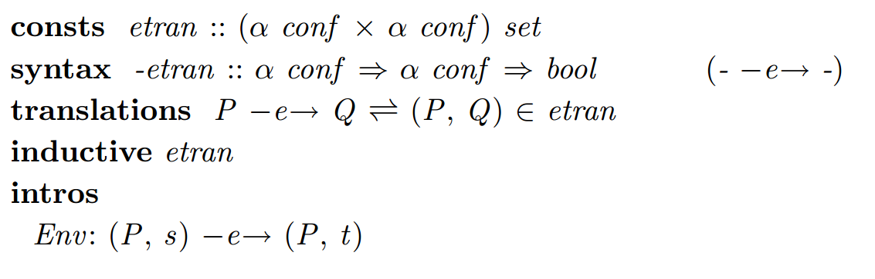
RG -- Operational Semantics
Semantics of Component Programs
Environment transitions, labelled with e, represent a step from the environment and can only change the state.

Slide 28
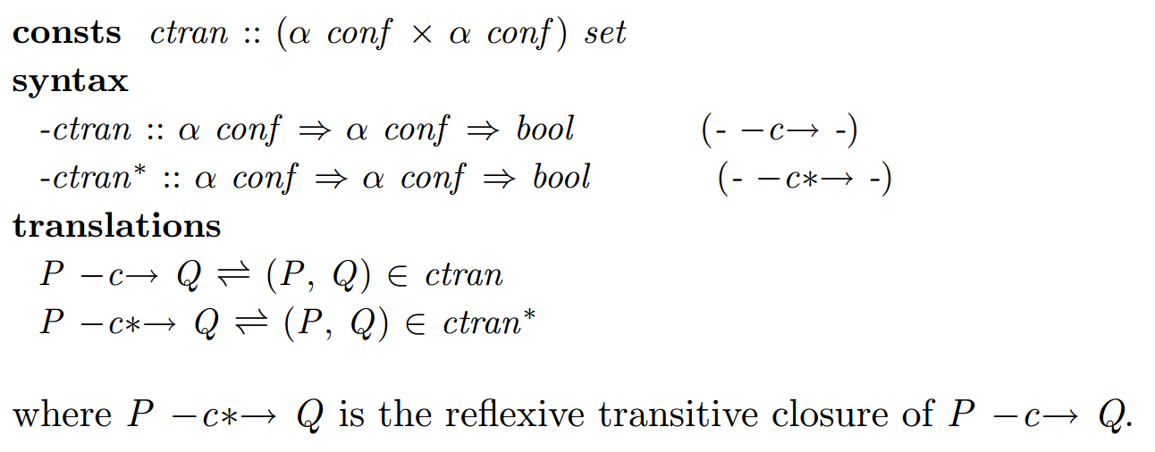
RG -- Operational Semantics
Semantics of Component Programs
Component transitions, labelled with c, represent a step of a sequential component program

Slide 29
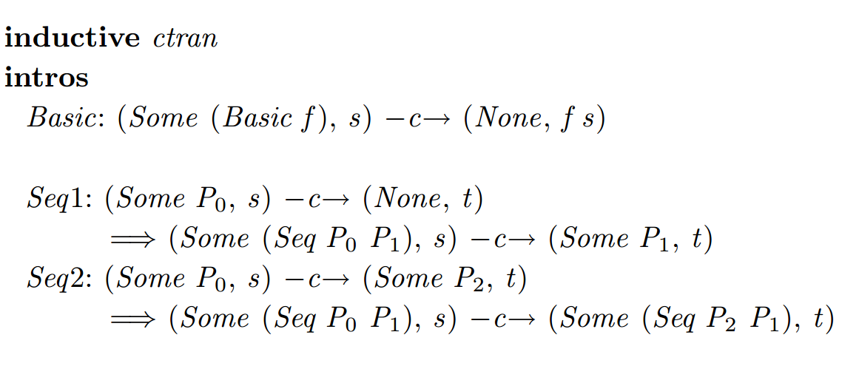
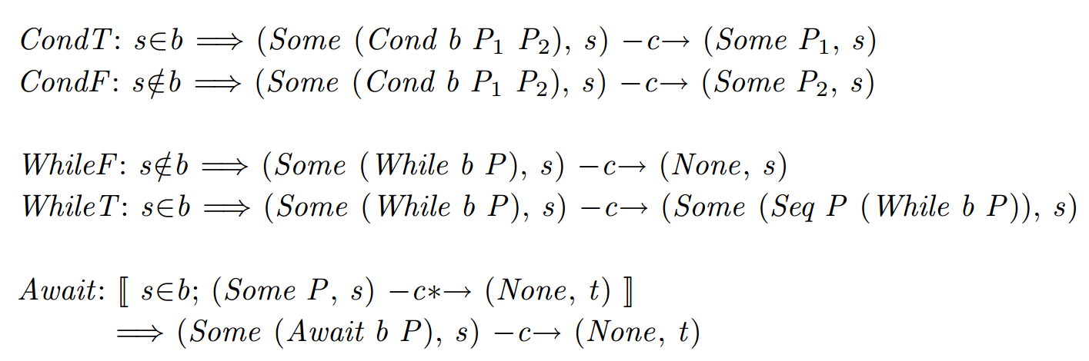
RG -- Operational Semantics
Semantics of Component Programs
Component transitions, labelled with c, represent a step of a sequential component program
Notes:
Basic actions and evaluation of boolean conditions are atomic. In both
conditional and iteration statements, the evaluation of the boolean tests are
atomic, but a step of the environment can interrupt between the boolean
test and the first action from the corresponding program body. The body of
an await-statement is executed atomically, thus no environment transitions
can occur.

Slide 30
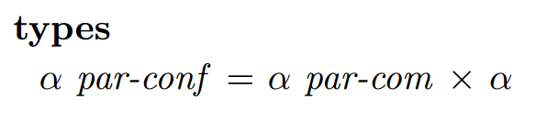
RG -- Operational Semantics
Semantics of Parallel Programs
A configuration for a parallel program is a pair formed by a program (α par-com) and a state. A parallel program has terminated if so have all its components.
Transitions may be from the environment, labelled with pe, or from the parallel program, labelled with pc.

Slide 31
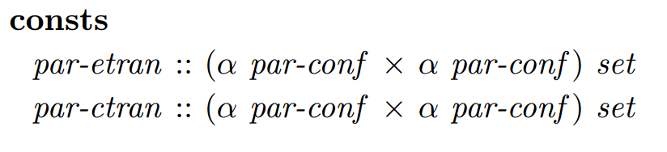
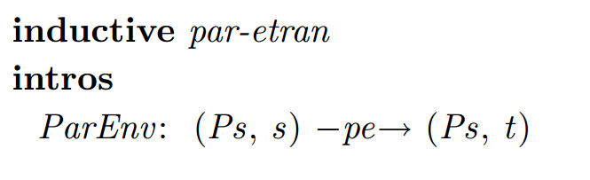
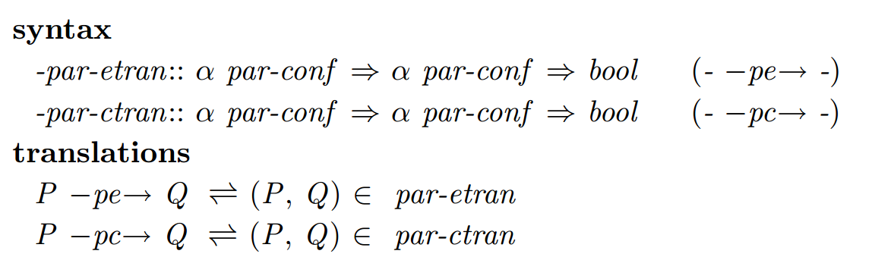
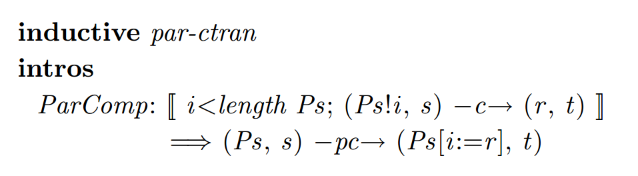
RG -- Operational Semantics
Semantics of Parallel Programs
Transitions

Slide 32
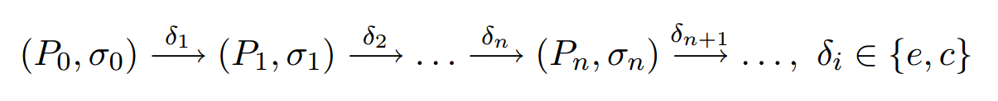
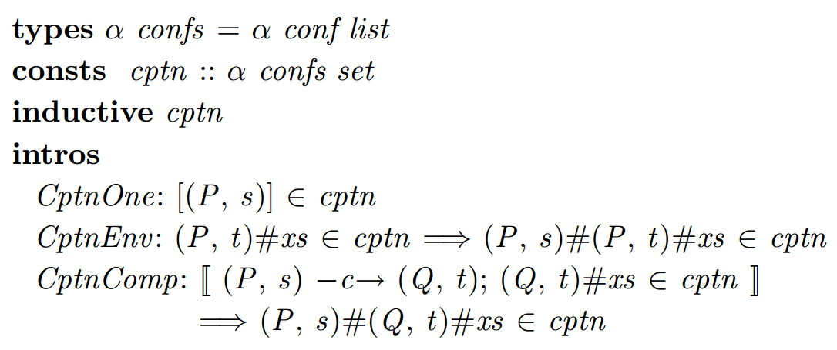
RG -- Operational Semantics
Computations
A computation is defined as any sequence of the form:
The solution we adopted is to model computations as an inductive set of lists of configurations. (Computations of component Programs)
Notes:
The one-element list is always a computation, and two inference rules, one for each kind of transition, determine which lists
belong to the inductive set.

Slide 33
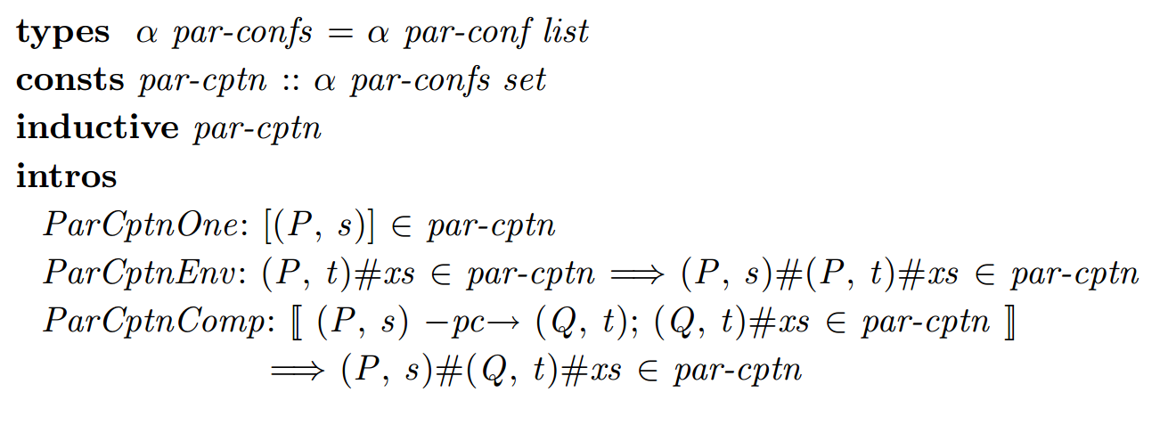
RG -- Operational Semantics
Computations
Computations of parallel programs

Slide 34
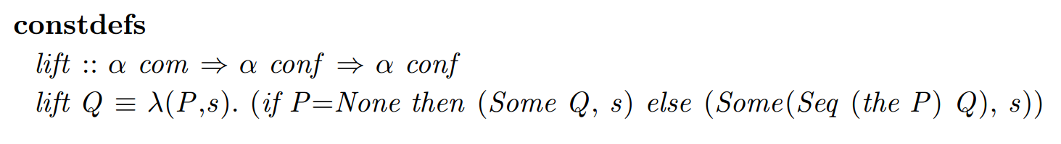
RG -- Operational Semantics
Modular Definition of Computation
The alternative definition for computations proposed in this section explicitly shows the structure of the program, thus considerably simplifying some proofs, especially those concerning properties of while-programs.
auxiliary function lift:
Notes:
The definition of computation of sequential programs presented in the previous section follows the one proposed in [Xu et al., 1997] and is probably the most natural and intuitive approach. However, it represents the execution of a program in a simplified linear way without taking into account the
inherent structure of the development of a computation.

Slide 35
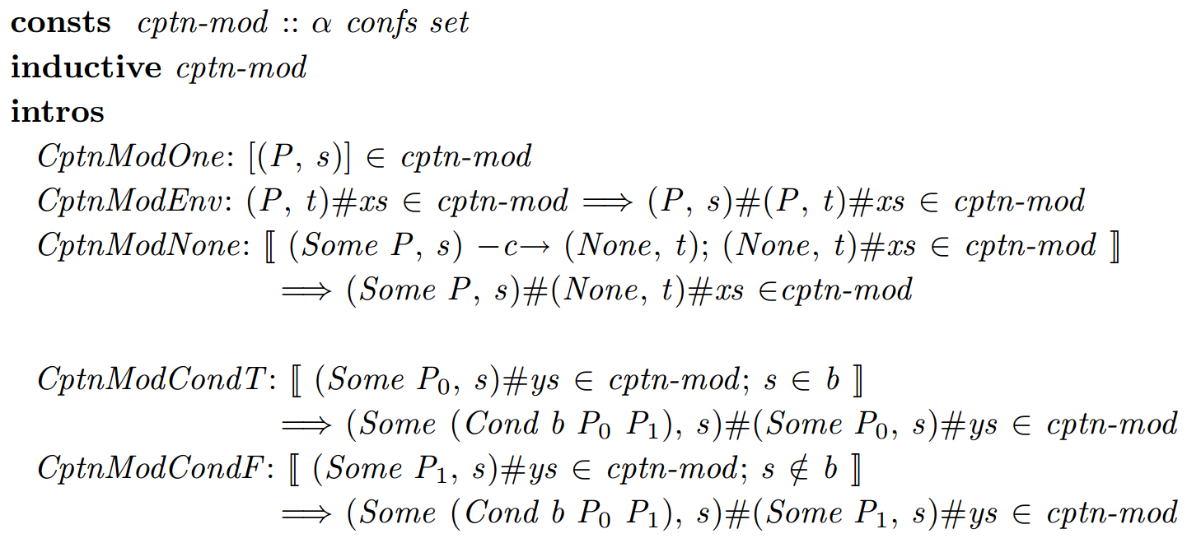
RG -- Operational Semantics
Modular Definition of Computation
Computations of component Programs

Slide 36
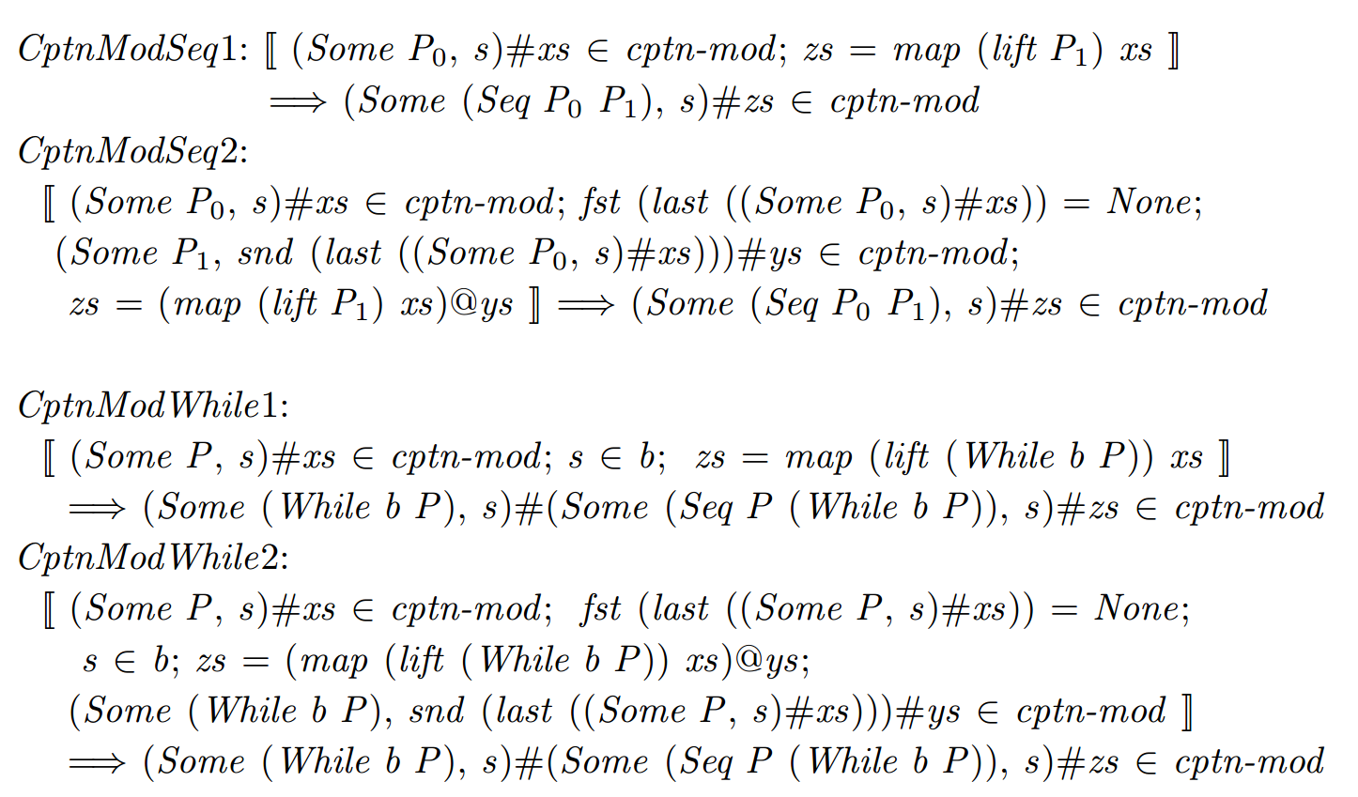
RG -- Operational Semantics
Modular Definition of Computation
Computations of component Programs
Notes:
Observe that for these five cases the new definition
does not provide any richer information than the CptnComp rule with case
analysis on the corresponding c-step.
The rule CptnModSeq1 represents the computations of a sequential composition where execution does not enter the second program, and CptnModSeq2 those who at least finish the first program. For while-programs
a computation might enter the body but not finish it (CptnModWhile1) or
finish it at least once (CptnModWhile2).

Slide 37
RG -- Operational Semantics
Modular Definition of Computation
The new definition is useful for proofs about computations of while programs because, in general, we do not know how often the body is executed. By using rule induction on cptn-mod we directly obtain the three following cases:
1. CptnModNone: the while-body is not entered.
2. CptnModWhile1: the execution of the body is at least started.
3. CptnModWhile2: the body is executed completely at least once followed by a new computation of the same while-program, on which the induction hypothesis holds.
(which is decisive for the proof of soundness while cptn is almost useless)

Slide 38
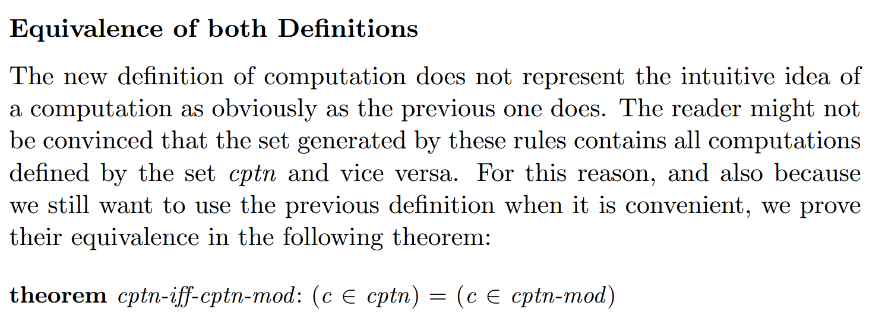

Slide 39
RG -- Validity of Correctness Formulas
A rely-guarantee correctness formula (or specification) of a program P consists of the quadruple (pre; rely; guar ; post). These four conditions can be classified in two parts:
Assumptions, represented by the pre- and rely condition, describe the conditions under which the program runs, and
Commitments, composed by the guarantee and postcondition, describe the expected behaviors of the program when it is run under the assumptions.
Notes:
Jones first suggested in [Jones, 1981] that the rely and guarantee conditions be reflexive and transitive. However, for the soundness proof only the
reflexivity of the guarantee condition is necessary.

Slide 40
RG -- Validity of Correctness Formulas
Validity for Component Programs
Specifications of sequential programs are written with the syntax P sat [pre, rely, guar, post] where sat stands for satisfies. The type of these tuples is:
Informally, we say that P satisfies its specification if under the assumptions that:
1 P is started in a state that satisfies pre, and
2 any environment transition in the computation satisfies rely,
then P ensures the following commitments:
3 any component transition satisfies guar, and
4 if the computation terminates, the final state satisfies post.

Slide 41
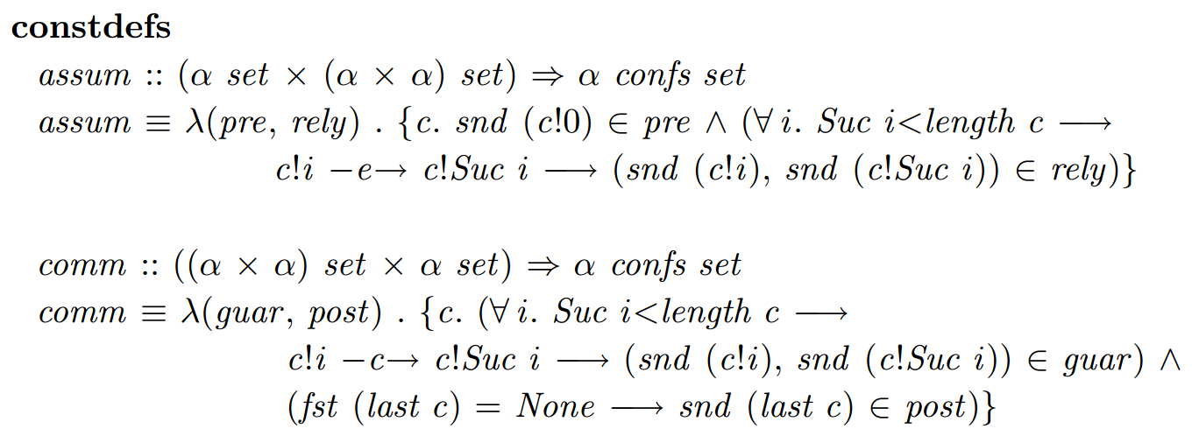
RG -- Validity of Correctness Formulas
Validity for Component Programs
The formal definitions are given by the functions:

Slide 42
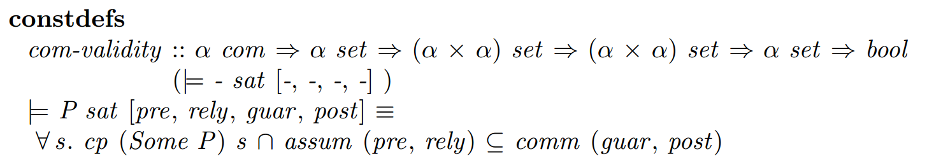
RG -- Validity of Correctness Formulas
Validity for Component Programs
A rely-guarantee specification of a sequential component program P is valid , and we use the usual syntax |= P sat [pre, rely, guar, post], if for any initial state, all computations of P that satisfy the assumptions satisfy the commitments.

Slide 43
RG -- Validity of Correctness Formulas
Validity for Parallel Programs
Parallel programs can be seen as a unit executed in a possibly interfering environment. For this reason, we include a rely and a guarantee condition in the specification of parallel programs as well.
They have the form P SAT [pre, rely, guar, post] where P has the type α par-com.

Slide 44
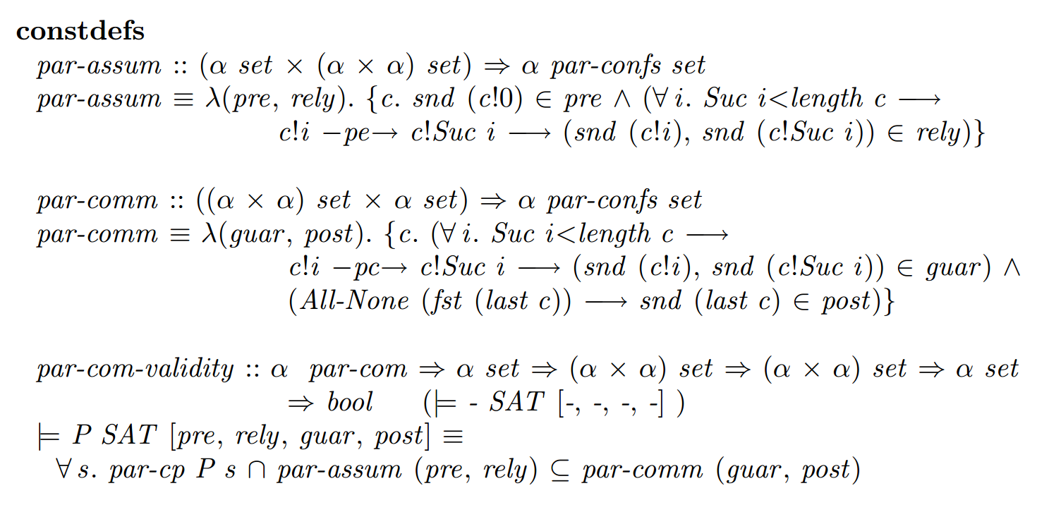
RG -- Validity of Correctness Formulas
Validity for Parallel Programs
The definition of assumptions, commitments and validity are analogous to the previous section:

Slide 45
RG -- The Proof System
The system of axioms and inference rules for deriving partial correctness formulas of parallel programs in the rely-guarantee formalism can be regarded as a compositional reformulation of the Owicki-Gries system. Due to the layered definition of the syntax, the set of all derivable specifications is defined using two sets:
1. The set of all derivable specifications of sequential programs: rghoare.
2. The set of all derivable specifications of parallel programs: par-rghoare.

Slide 46
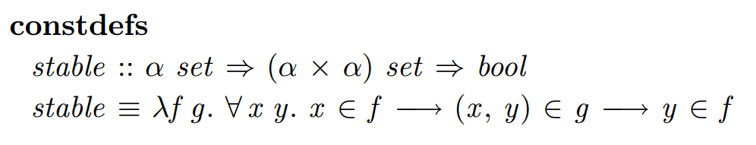
RG -- The Proof System
Proof System for Component Programs
first define a predicate about stability needed in the rules:
For example, stable pre rely means that if a state belongs to the precondition and some transition satisfies the rely condition, then the reached state still belongs to the precondition.

Slide 47
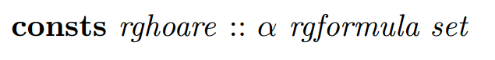
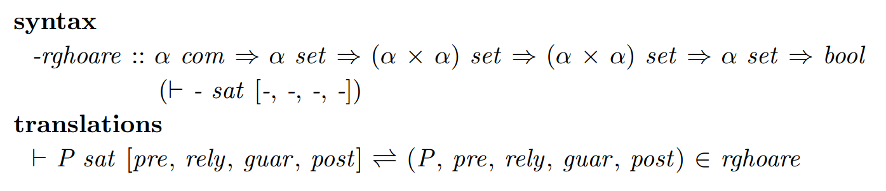
RG -- The Proof System
Proof System for Component Programs
The set of all derivable specifications is defined by the constant:
where α rgformula is the type of a specification of a sequential component program. A derivable specification is denoted with the usual syntax:

Slide 48
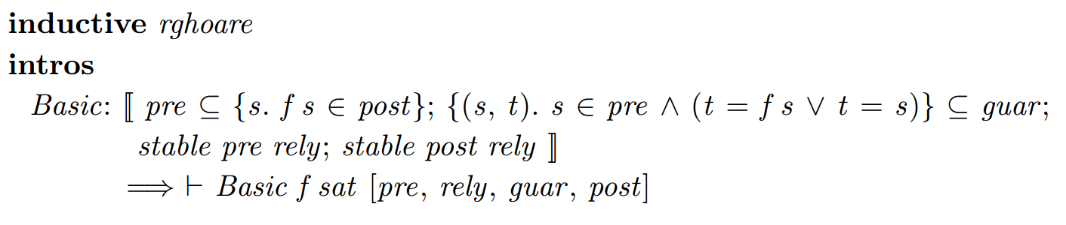
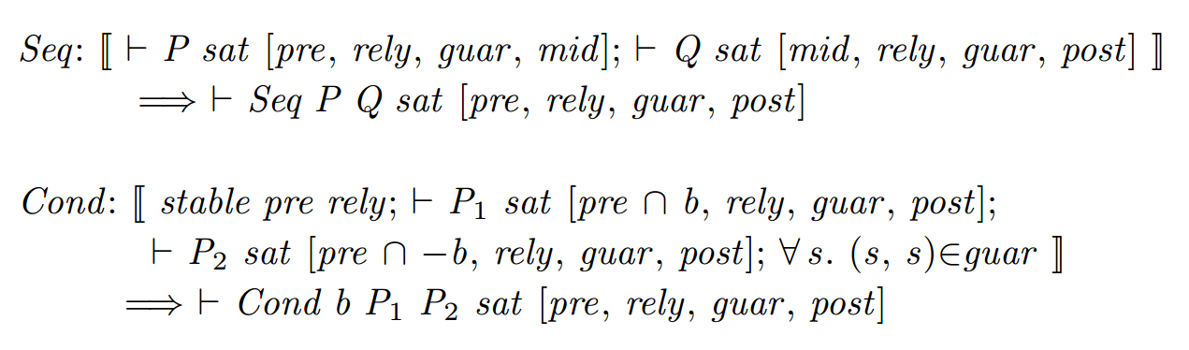
RG -- The Proof System
Proof System for Component Programs(identity transformation?)

Slide 49
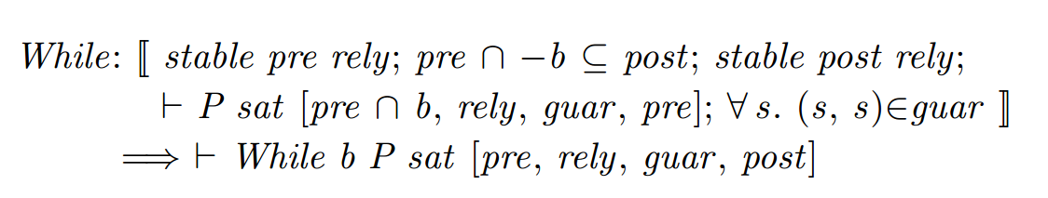
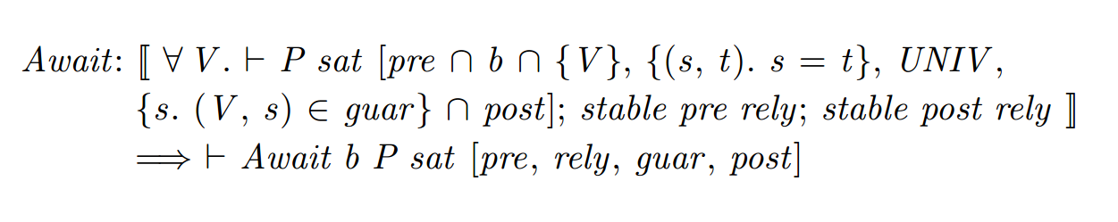
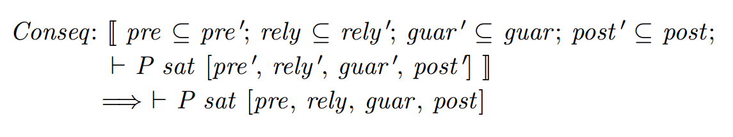
RG -- The Proof System
Proof System for Component Programs
Notes:
By the semantics of the await-command, a positive evaluation of the condition and the execution of the body is done atomically. Thus, the state
transition caused by the complete execution of P must satisfy the guarantee
condition. This is reflected in the precondition and postcondition of P in
the assumptions; since these are sets of single states, the relation between
the state before and after the transformation is established by fixing the
values of the first via a universally quantified variable V. The intermediate
state changes during the execution of P must not guarantee anything, thus
the guarantee condition is the universal set UNIV. However, since they are
executed atomically, the environment cannot change their values. This is
reflected by the rely condition f(s; t): s = tg. To ensure that the postcondition holds at the end of the computation, regardless of possible environment
transitions, we require stable post rely.

Slide 50
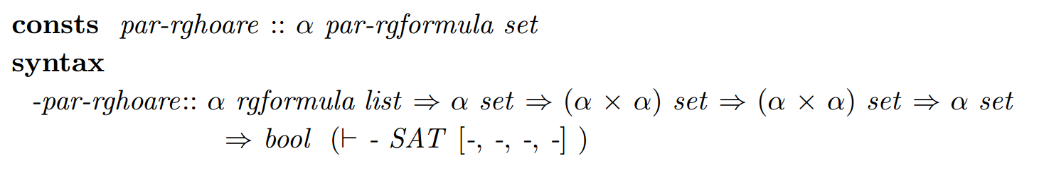
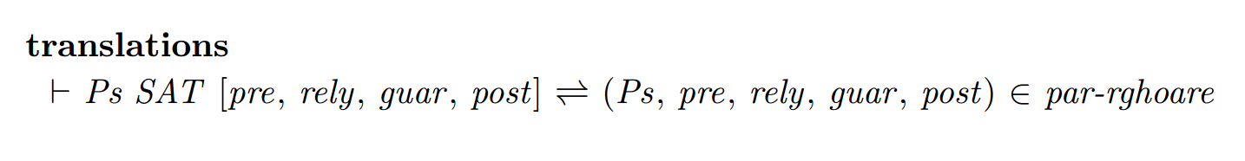
RG -- The Proof System
Proof System for Parallel Programs
Different from the definition of validity for parallel programs , the conclusion should include all the information( pre , rely . . .) needed in the premises of the rule.
Notes:
Do not confuse the type of the first argument. Here it is a list of specifications
of sequential component programs, while in |= P SAT [pre; rely; guar ; post],
P is just a program of type α par-com.

Slide 51
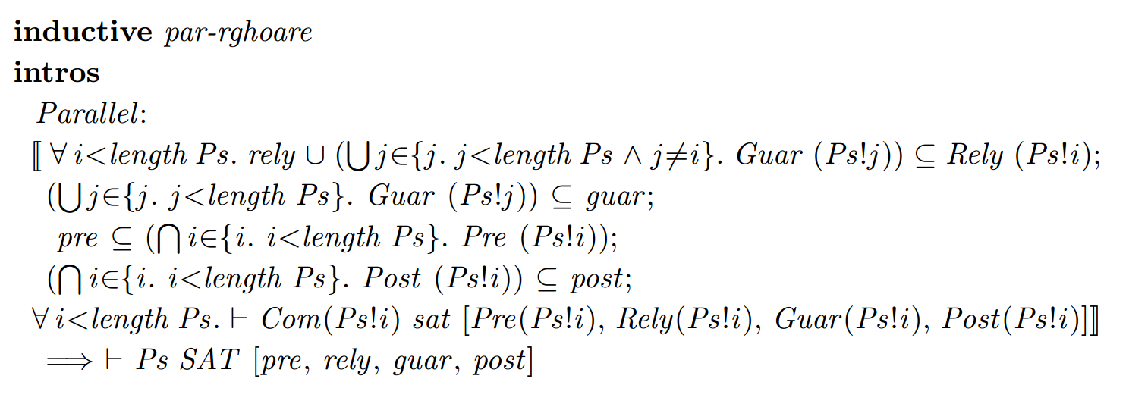
RG -- The Proof System
Proof System for Parallel Programs

